Slide 1

Advanced Grow Lighting & Sensing Systems from Lumens³® of uriel corporation® ARE exclusively integrateD With SensorS & actuated Devices for complete control over growing operations with one integrated system.
Point of Contact: Peter J. Panopoulos, President, CEO, Founder Uriel Corporation® www.lumenscubed.com Lighting & Sensing Systems Subsidiary One Westbrook Corporate Center, Suite 300 Westchester, IL 60154-5709 management@urielcorporation.com 1 (708) 598-7314

Slide 2
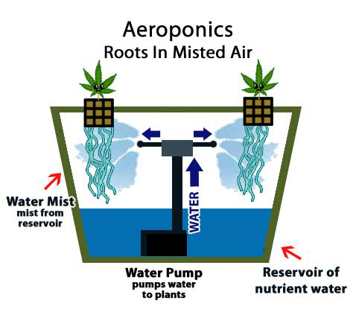
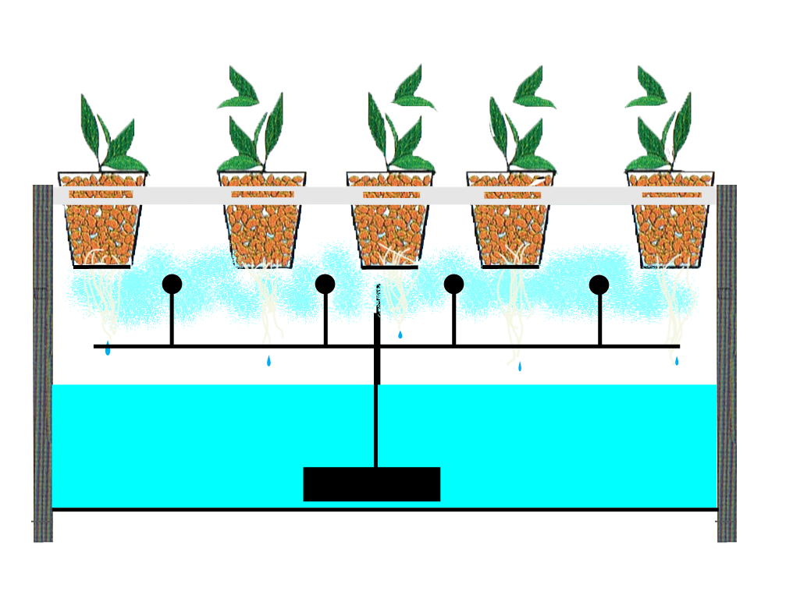
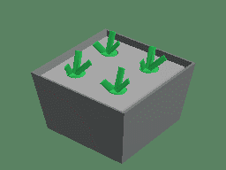
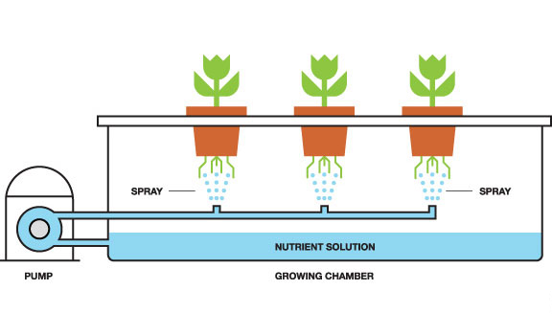
Uriel Corporation’s Advanced Grow Lighting & Sensing Systems Integrate with, Control & Actuate Aeroponics Growing Systems automatically & manually through smartphones & computers.

Slide 3
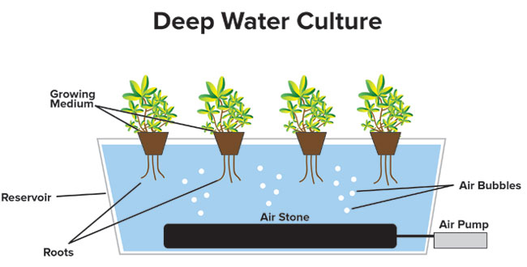
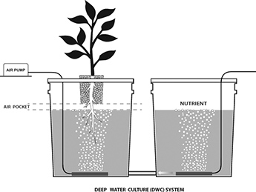
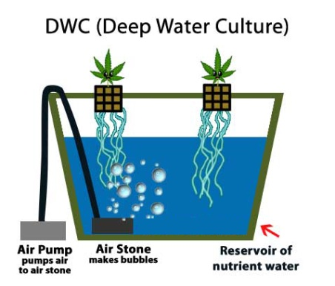
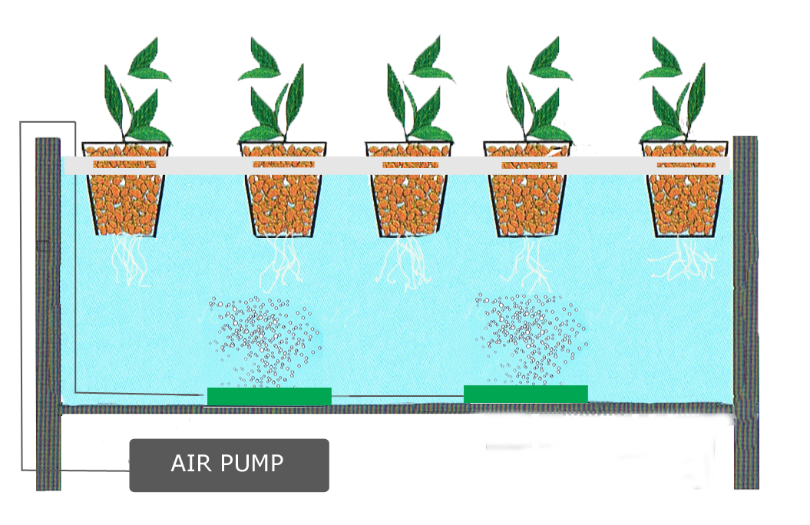
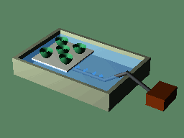
Uriel Corporation’s Advanced Grow Lighting & Sensing Systems Integrate with, Control & Actuate Deep Water Culture Growing Systems automatically & manually through smartphones & computers.

Slide 4
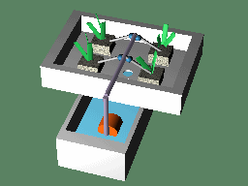
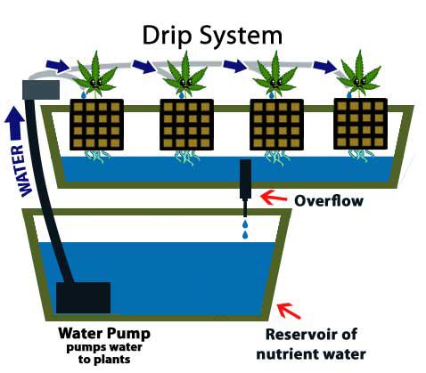
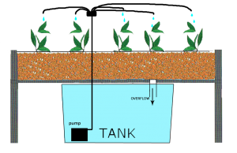
Uriel Corporation’s Advanced Grow Lighting & Sensing Systems Integrate with, Control & Actuate Drip Water Culture Growing Systems automatically & manually through smartphones & computers.

Slide 5
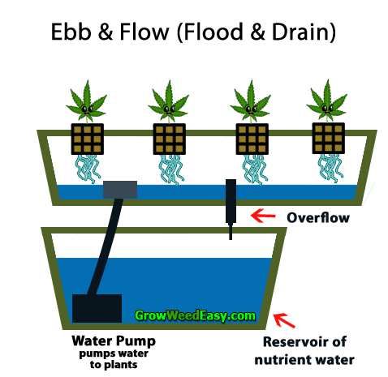
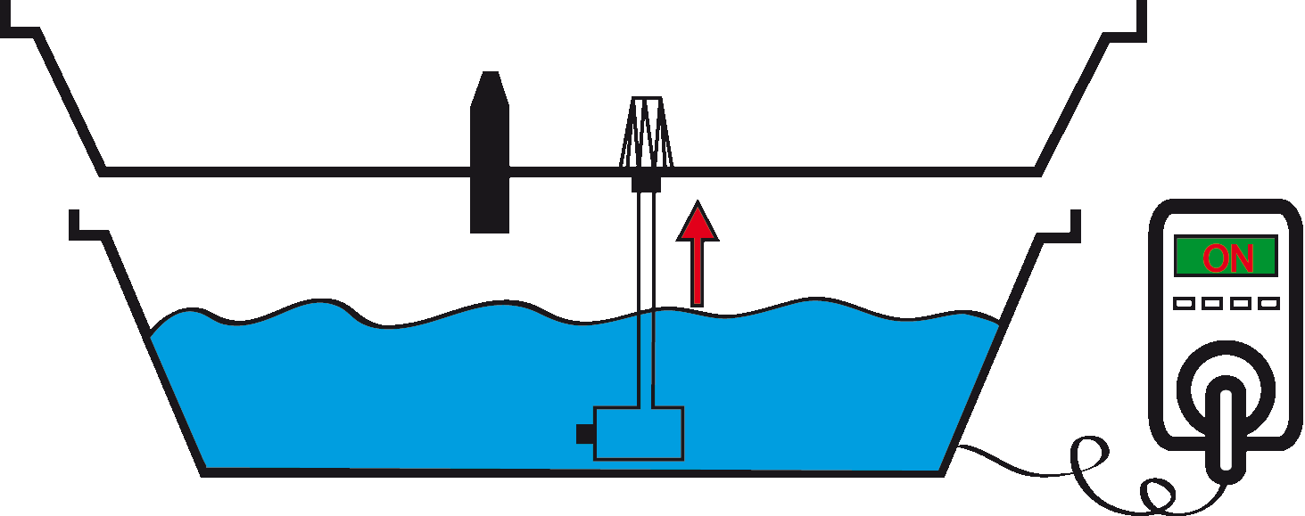
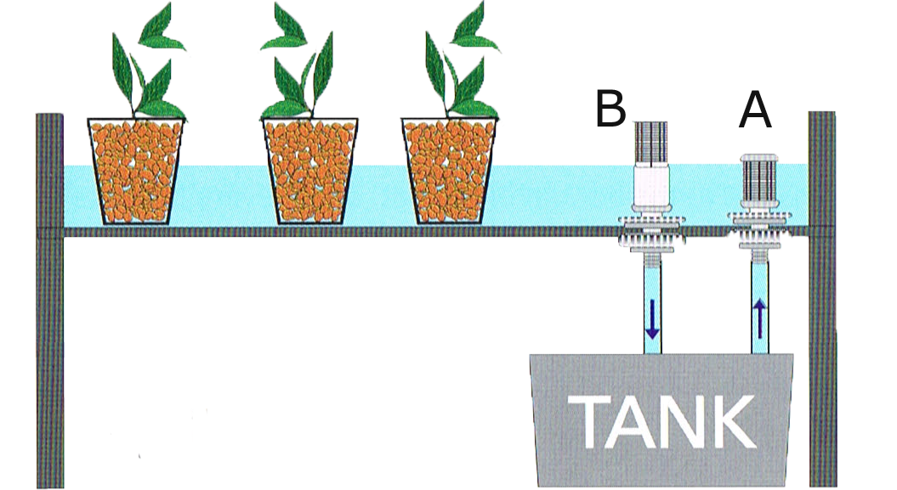
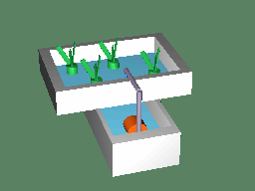
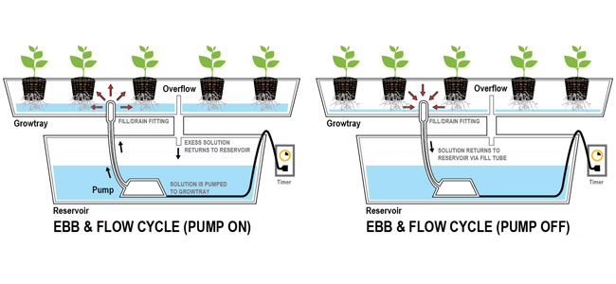
Uriel Corporation’s Advanced Grow Lighting & Sensing Systems Integrate with, Control & Actuate Ebb & Flow Water Culture Growing Systems automatically & manually through smartphones & computers.

Slide 6
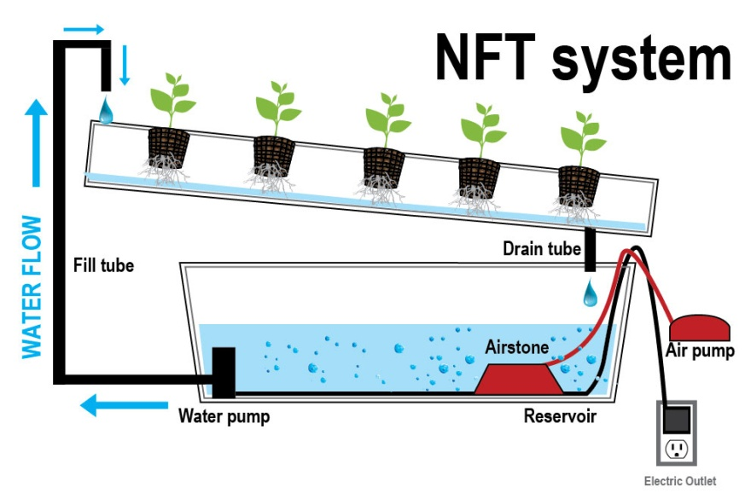
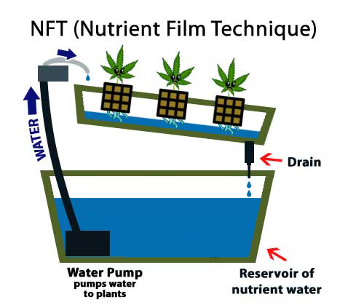
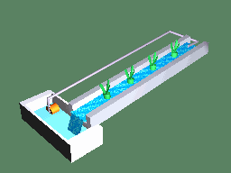
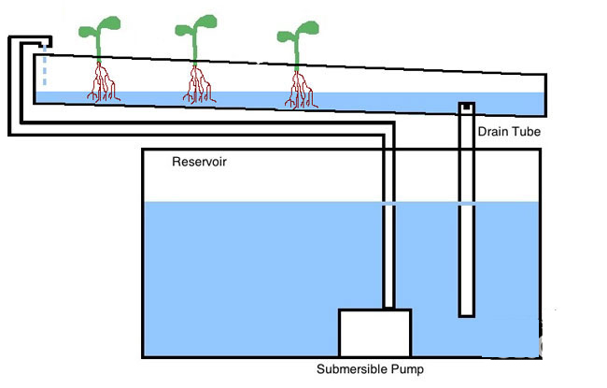
Uriel Corporation’s Advanced Grow Lighting & Sensing Systems Integrate with, Control & Actuate Nutrient Film Technique (NFT) Water Culture Growing Systems automatically & manually through smartphones & computers.

Slide 7
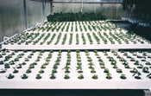
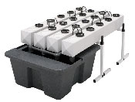
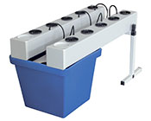
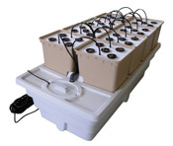
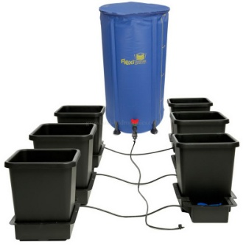
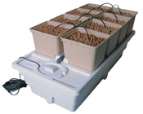
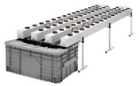
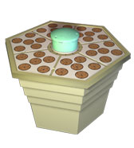
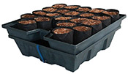
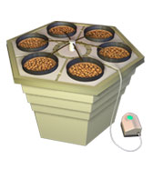
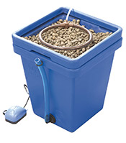
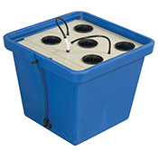
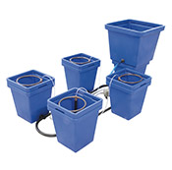
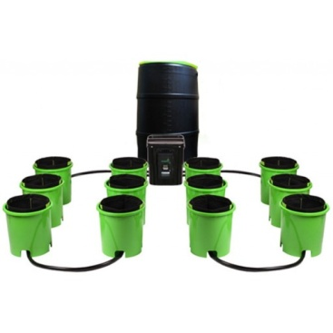
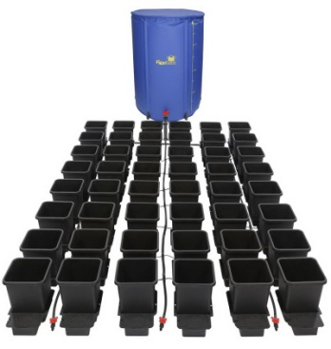
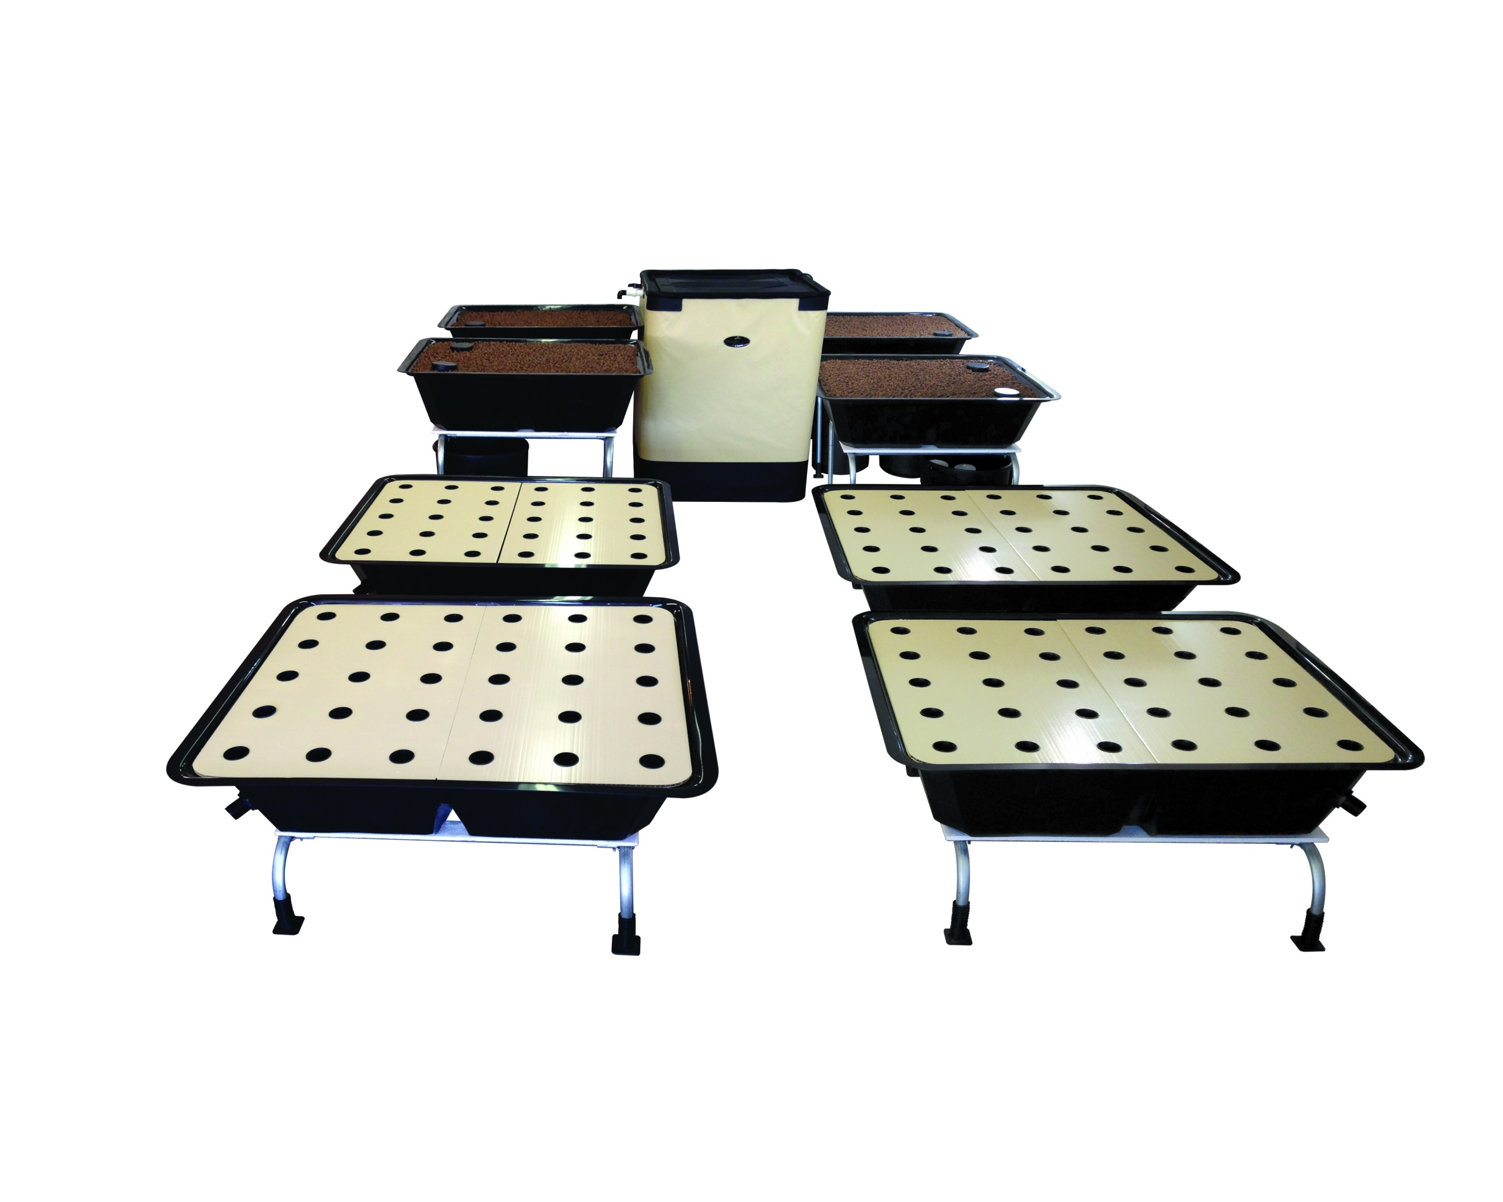
Uriel Corporation’s Advanced Grow Lighting & Sensing Systems Integrate with, Control & Actuate Various Water Culture Growing Systems automatically & manually through smartphones & computers.

Slide 8
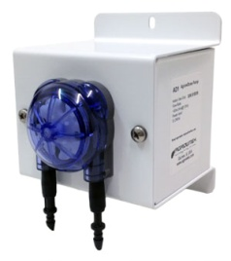
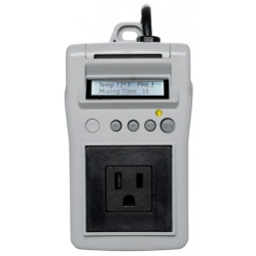
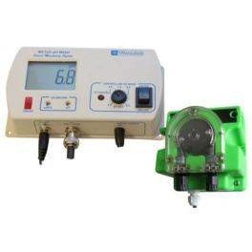
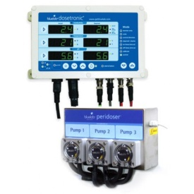
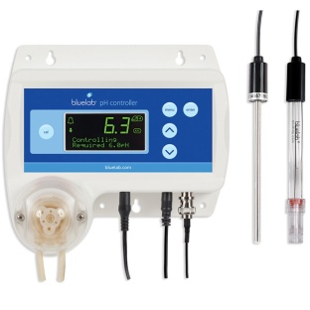
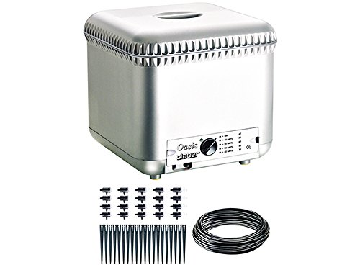
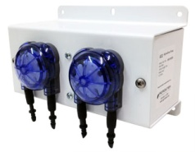
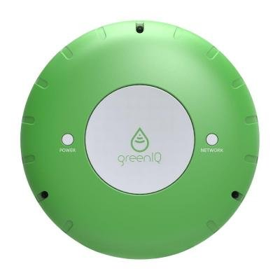
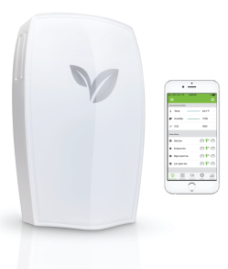
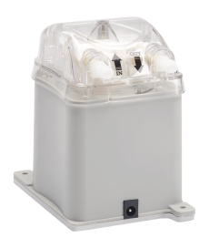
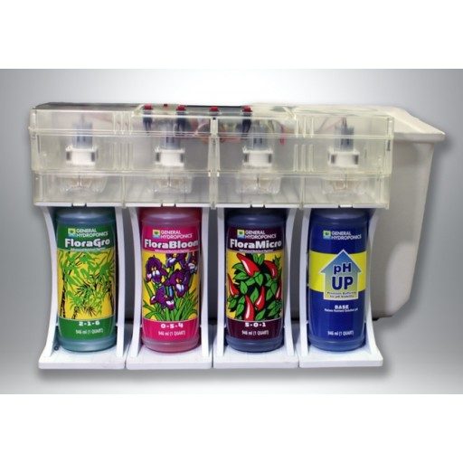
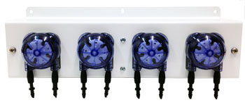
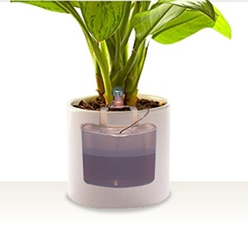






Uriel Corporation’s Advanced Grow Lighting & Sensing Systems Integrate with, Control & Actuate Various Water Pump, pH Dosage, & Nutrient Dosage Systems automatically & manually through smartphones & computers.

Slide 9




Uriel Corporation’s Advanced Grow Lighting & Sensing Systems Integrate with, Control & Actuate Various Water Chiller & Water Heater Systems automatically & manually through smartphones & computers.

Slide 10





















Uriel Corporation’s Advanced Grow Lighting & Sensing Systems Integrate with, & send sensor data to smartphones & computers from a vast array of sensors, including but not limited to: temperature, humidity, pH, EC, TDS, CO2, water level, intensity, color, moisture, O2, ozone, air quality, algae, leaf, smoke, etc.

Slide 11





Uriel Corporation’s Advanced Grow Lighting & Sensing Systems Integrate with, Control & Actuate a vast array of devices, including but not limited to: Thermostats automatically & manually through smartphones & computers.

Slide 12







Uriel Corporation’s Advanced Grow Lighting & Sensing Systems Integrate with, Control & Actuate a vast array of devices, including but not limited to: CO2 Controllers and CO2 Generators automatically & manually through smartphones & computers. :

Slide 13









Uriel Corporation’s Advanced Grow Lighting & Sensing Systems Integrate with, Control & Actuate a vast array of devices, including but not limited to: Environmental Controllers automatically & manually through smartphones & computers.

Slide 14






Uriel Corporation’s Advanced Grow Lighting & Sensing Systems Integrate with, Control & Actuate a vast array of devices, including but not limited to: AC, Fan Controllers & Ozone Generators automatically & manually through smartphones & computers.

Slide 15









Uriel Corporation’s Advanced Grow Lighting & Sensing Systems Integrate with, Control & Actuate a vast array of devices, including but not limited to: Light & Photoperiod Controllers automatically & manually through smartphones & computers.

Slide 16







Uriel Corporation’s Advanced Grow Lighting & Sensing Systems Integrate with, Control & Actuate a vast array of devices, including but not limited to: Power & Relay Controllers automatically & manually through smartphones & computers.

Slide 17





Uriel Corporation’s Advanced Grow Lighting & Sensing Systems Integrate with, Control & Actuate a vast array of devices, including but not limited to: Timer Controllers automatically & manually through smartphones & computers.

Slide 18

Uriel Corporation’s Advanced Grow Lighting & Sensing Systems Integrate with, Control & Actuate all Growing Systems & Subsystems automatically & manually through smartphones & computers.

Slide 19

Uriel Corporation’s Advanced Grow Lighting & Sensing Systems Integrate with, Control & Actuate all Growing Systems & Subsystems automatically & manually through smartphones & computers.

Slide 20

Uriel Corporation’s Advanced Grow Lighting & Sensing Systems Integrate with, Control & Actuate all Growing Systems & Subsystems automatically & manually through smartphones & computers.

Slide 21


Uriel Corporation’s Advanced Grow Lighting & Sensing Systems Integrate with, Control & Actuate all Growing Systems & Subsystems automatically & manually through smartphones & computers.

Slide 22


Uriel Corporation’s Advanced Grow Lighting & Sensing Systems Integrate with, Control & Actuate all Growing Systems & Subsystems automatically & manually through smartphones & computers.

Slide 23






Uriel Corporation’s Advanced Grow Lighting & Sensing Systems. Technology to grow with. Lumens³® of Uriel Corporation®.

Slide 24
Advanced Grow Lighting & Sensing Systems from Lumens³® of uriel corporation® ARE exclusively integrated With SensorS & actuated Devices for complete control over growing operations with one integrated system.
Point of Contact: Peter J. Panopoulos, President, CEO, Founder Uriel Corporation® www.lumenscubed.com Lighting & Sensing Systems Subsidiary One Westbrook Corporate Center, Suite 300 Westchester, IL 60154-5709 management@urielcorporation.com 1 (708) 598-7314

